Slide 1


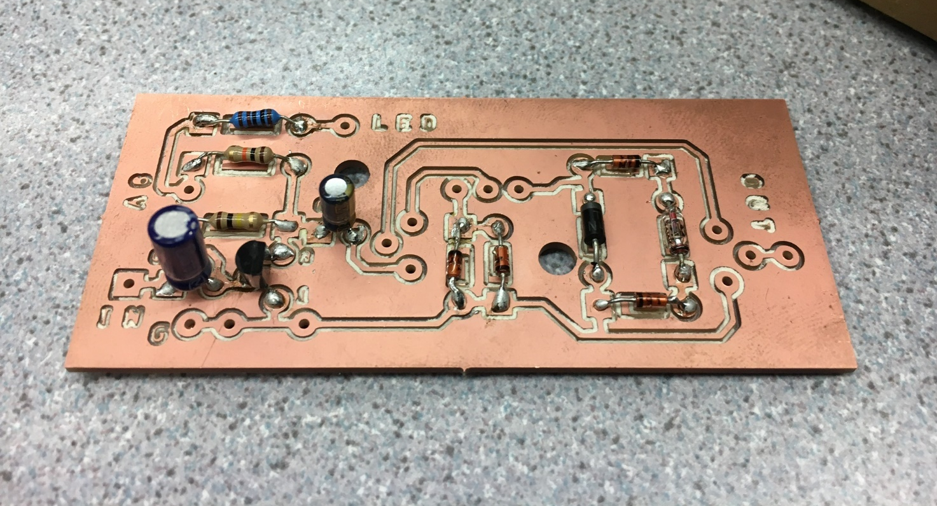
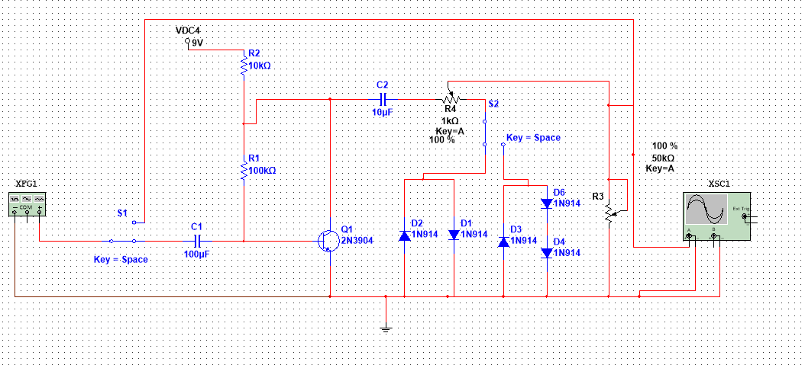
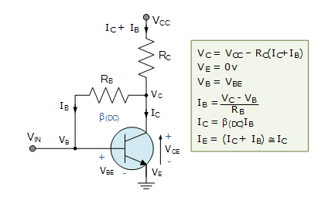
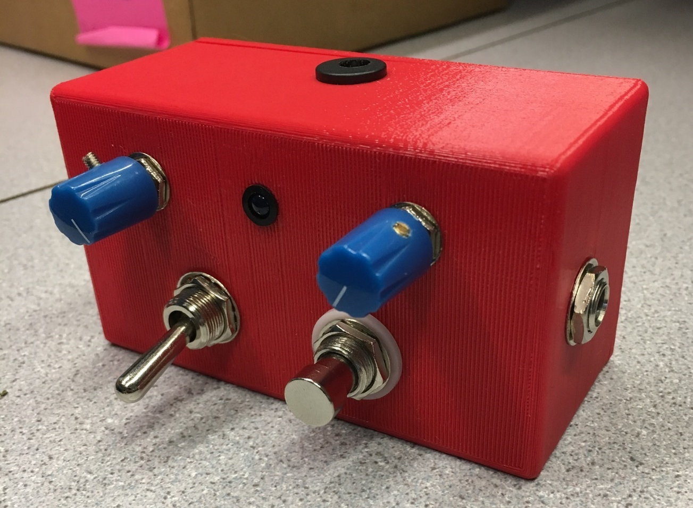
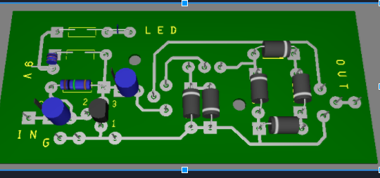
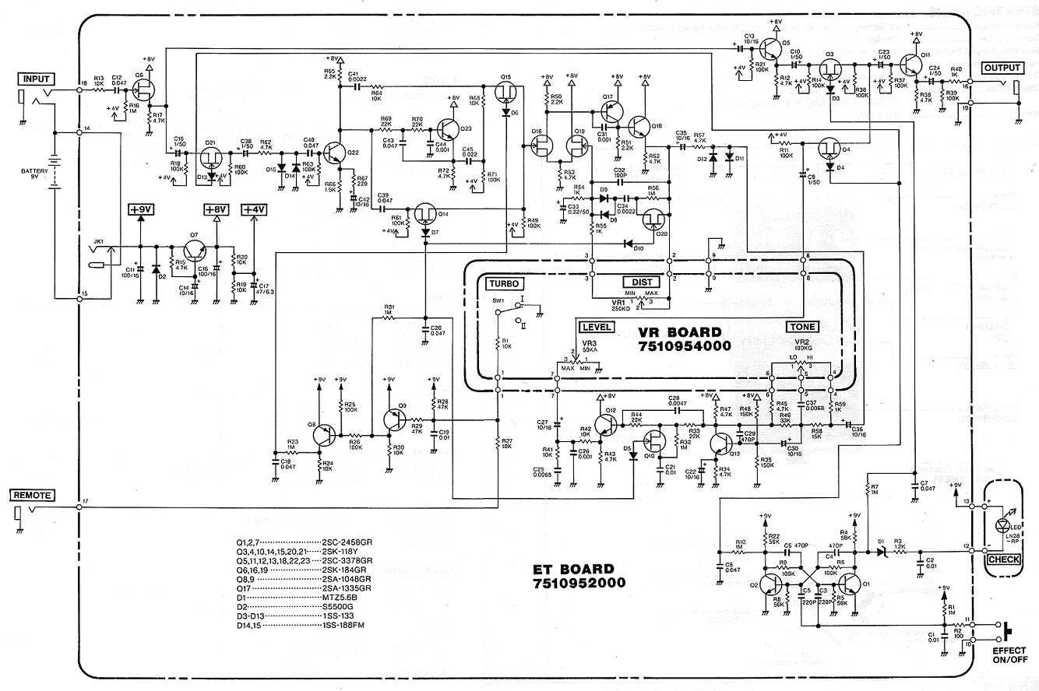
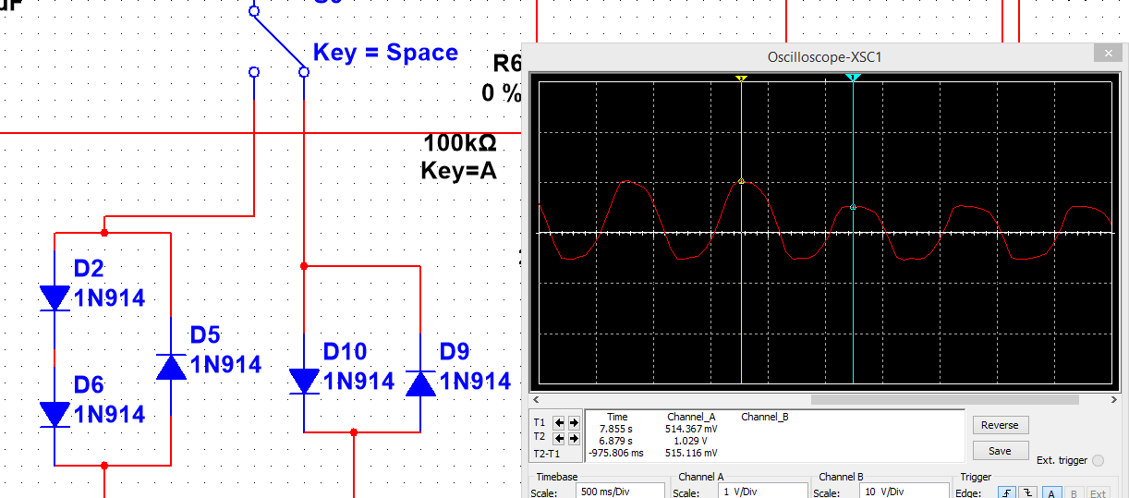
Distortion Pedal Upgrade
CJ Porter – Dave Villandry – Brad McIsaac
Professor Santacroce
Wentworth Institute of Technology
Abstract
Methods/Materials
Combined with diode clipping, the use of transistor biasing gives the pedal a fuzzy, distortion tone. Below are the calculations used to select specific components.
Use schematic design principles to simplify the design and maintain the sound quality of electric guitar pedal circuits. Apply design techniques that will generate new sounding pedals which beginner, experienced, and master musicians can rely on.
Figure6: Carvey PCB
Introduction
Above is the populated PCB that was manufactured using a drilling machine called “Carvey”. We then used a 3D printer to print the encasing that will fit all of the electrical components and the PCB. ( Reference Figure 7)
Figure2: Schematic
Circuit design techniques and the reverse engineering of professional pedals were used along with knowledge of enclosure manufacturing and the development process of a printed circuit board. The objective of this project is to redesign and simplify complex circuits of current guitar pedals to save space (Reference Figure 1) while keeping the overall sound quality.
Diode Clipping: This circuit utilized symmetrical and asymmetrical diode configurations. Both hard and soft clipping waveforms were created.
Since the threshold of a clipping diode is additive when diodes are in series the positive and negative wave cycles can be different.
Figure4: Transistor Biasing
Figure7: 3D Printed Encasing
Conclusions
Figure5: Ultiboard PCB
Reverse engineering was a strategy that allowed us to learn more about how different guitar pedals work, as well as obtaining ideas for designing a simpler circuit. Advanced circuit design techniques such as soft/hard clipping of diodes and were researched heavily and implemented into the design.
Ultiboard utilizes accurate component sizes, and provides a 3D view of the design to aid in the process. A basic printed circuit board design of a general circuit (Reference Figure 5). was used to get familiar with Ultiboard, as it has fewer components than the final design.
Figure1: Boss-Distortion
Figure3: Diode Clipping

